Slide 1

Department of Computer Science and Engineering
CNN-Driven Detection of Abnormalities in PCG Signals using Gammatonegram Analysis
PRESENTED BY
Tata Sumanth 21471A05D2
Katragadda Somanth 21471A0596
L.V. Pavan Kumar 21471A05D7
Linagala Brahmaiah 21471A05A0
Under the Guidance of,
Dr. Moturi Sireesha _{M.Tech., Ph.D.}
Designation,
Department of Computer Science and Engineering,
Narasaraopeta Engineering College (Autonomous),
Narasaraopet- 522 601.

Slide 2
OUTLINE
Abstract
Introduction
Literature Survey
Research Gaps
Problem Statement
Objectives
Block Diagram / Flow Diagram
Methodology
Implementation
Results and Analysis
Conclusion & Future Scope
References
Question and Answers
Acknowledgements

Slide 3
ABSTRACT
Phonocardiogram (PCG) signals carry essential data about heart health, offering significant potential for early disease detection. This study presents a method to identify heart abnormalities using Gammatonegram images derived from PCG signals, which are analyzed with a Convolutional Neural Network (CNN). The Gammatonegram, a time-frequency representation mimicking human auditory processing, captures both temporal and spectral features of PCG signals. The images are preprocessed through resizing and data augmentation, the images are input into the CNN model for classification. The model distinguishes between healthy and unhealthy heart sounds, and its performance is evaluated using several optimizers—SGD, Adagrad, Adadelta, RMSProp, and Adam. Adam yielded the best performance, achieving a test accuracy of 100%. This method provides a robust, non invasive solution for heart disease diagnosis, leveraging deep learning to improve accuracy in detecting heart abnormalities from PCG signals.

Slide 4
INTRODUCTION
Heart diseases remain a leading cause of mortality worldwide. Early detection and diagnosis are crucial for effective treatment and improved patient outcomes.
Traditional methods for analyzing PCG signals often involve manual feature extraction, which can be time-consuming and prone to human error.
This research aims to develop an automated and accurate system for detecting heart abnormalities using deep learning techniques.
The proposed method utilizes Gammatonegram analysis to extract relevant features from PCG signals, which are then fed into a CNN for classification.

Slide 5
LITERATURE SURVEY
No | Title | Author | Journal Name & Year | Methodology Adapted | Key Findings | Gaps
1 | Ensemble Learning for Accurate Prediction of Heart Sounds. | Ashinikumar Singh et al. | Turkish Journal of Electrical Engineering, 2024 | Ensemble learning with CNNs on Gammatonegram images. | Achieved 99.51% accuracy on PhysioNet 2016 dataset. | Limited real-time implementation exploration.
2 | Heart Sound Classification Using Gammatonegram and SVM. | Taneja et al. | Multimedia Tools and Applications, 2024 | Texture-based feature extraction with SVM classification. | 94% accuracy with high precision and F1 scores. | Dataset size and noise handling limitations.
3 | Transfer Learning-Based Heart Valve Disease Classification. | Maity et al. | Biomedical Signal Processing and Control, 2023 | Transfer learning with YAMNet and spectrogram representations. | 92.23% accuracy (PhysioNet); 99.83% (HVD dataset). | High computational needs and lightweight model limitations.
4 | CatBoost Model for Diastolic Dysfunction Detection. | Zheng et al. | Computers in Biology and Medicine, 2023 | Gammatonegram with pre-trained CNNs and CatBoost. | 91.1% AUC, 88.2% accuracy for LVDD detection. | Computational intensity and limited generalization.
5 | Phonocardiogram Classification with Wavelet Scattering | Ismael et al. | Biomedical Signal Processing and Control, 2024 | Wavelet transform and KNN classification. | Achieved 99.5% accuracy. | Lack of deep learning framework integration.

Slide 6
RESEARCH GAPS
Lack of studies integrating CNNs with Gammatonegram representations for abnormality detection.
Challenges in addressing noise and variability in real-world PCG datasets.
Limited scalability of existing methods for large datasets.
Need for robust models capable of real-time applications.

Slide 7
PROBLEM STATEMENT
Traditional methods for diagnosing heart abnormalities are invasive, costly, and inaccessible in resource-limited settings. Manual interpretations are prone to errors, creating a need for a reliable, non-invasive, and affordable diagnostic tool.
This research develops a CNN-based method using Gammatonegram images of PCG signals to provide an accurate, scalable, and accessible solution for early heart disease detection, especially in underserved regions.

Slide 8
OBJECTIVES
To preprocess PCG signals and generate Gammatonegram images.
To design a CNN architecture optimized for PCG classification.
To evaluate the model’s accuracy and robustness under varied conditions.
To validate performance using different optimizers and real-world datasets.
Addressing Data Imbalance

Slide 9
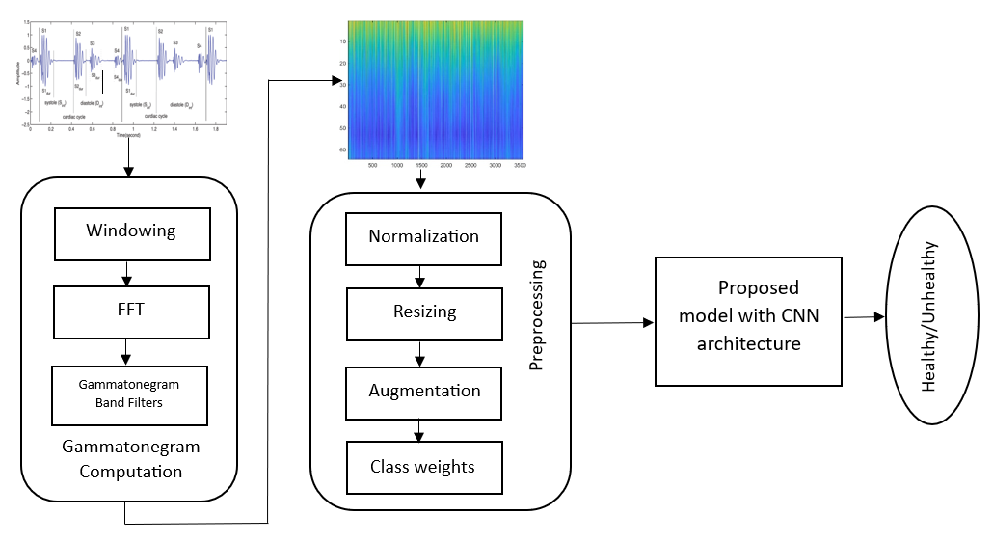
BLOCK DIAGRAM / FLOW DIAGRAM

Slide 10
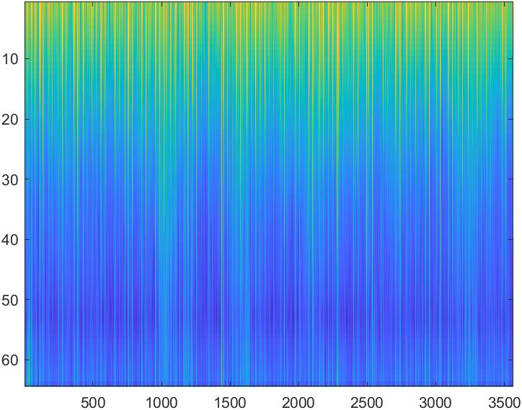
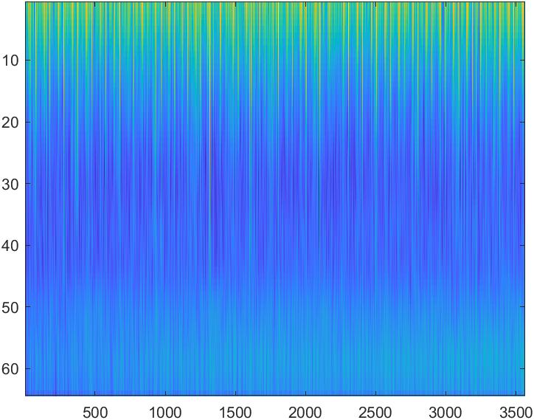
METHODOLOGY
Data Set :
Source : Kaggle (Gammatonegram images dataset)
Size : 3541 image, 2 features
Target Variable : ( 0 : Healthy, 1: Unhealthy )
Dataset Composition:
Training Data: 3,240 images (2,575 healthy, 665 unhealthy)
Validation Data: 301 images (150 healthy, 151 unhealthy)
Healthy
Unhealthy

Slide 11
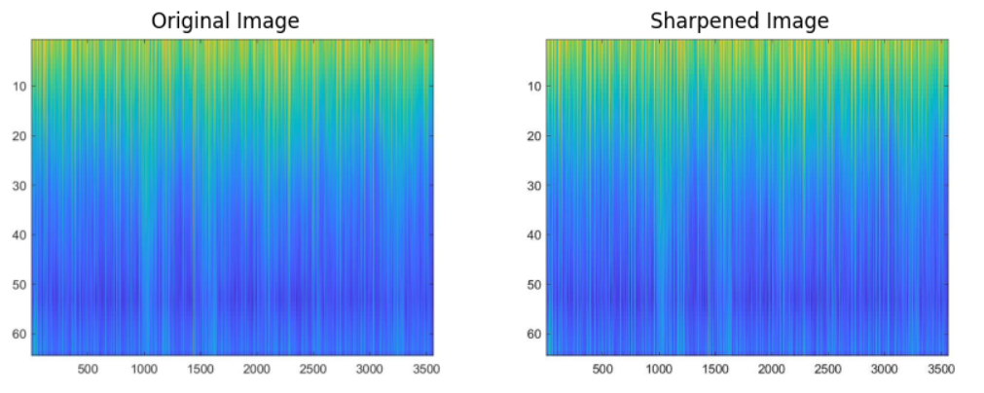
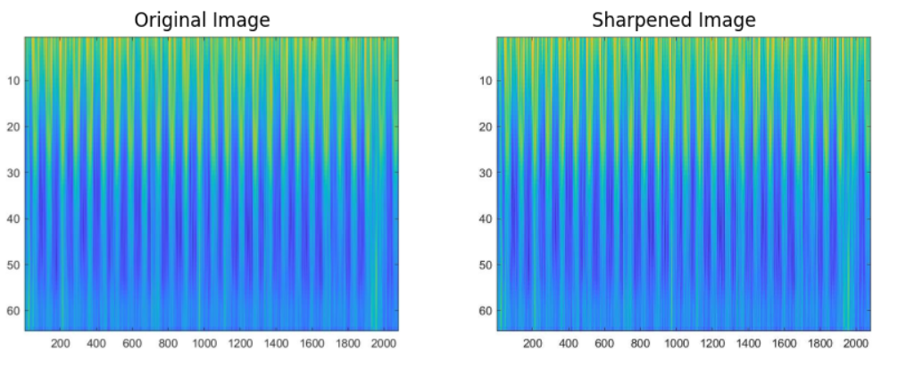
Data Preprocessing
Normalization : Normalization is a technique which is used to scale data into a standard range; often, a range of 0 to 1 or -1 to 1 is considered standard.
Resizing : Resizing is the process of the altering the dimensions of the images to match the input size required by the neural network. The input images are resized to 150×150 and fed to the CNN model.
Augmentation : Data augmentation is used to increase the size of a training dataset by altering the original images in some different ways like random rotations, flipping, shifts, zooms, cropping and sharpening.
Healthy image
Unhealthy image

Slide 12
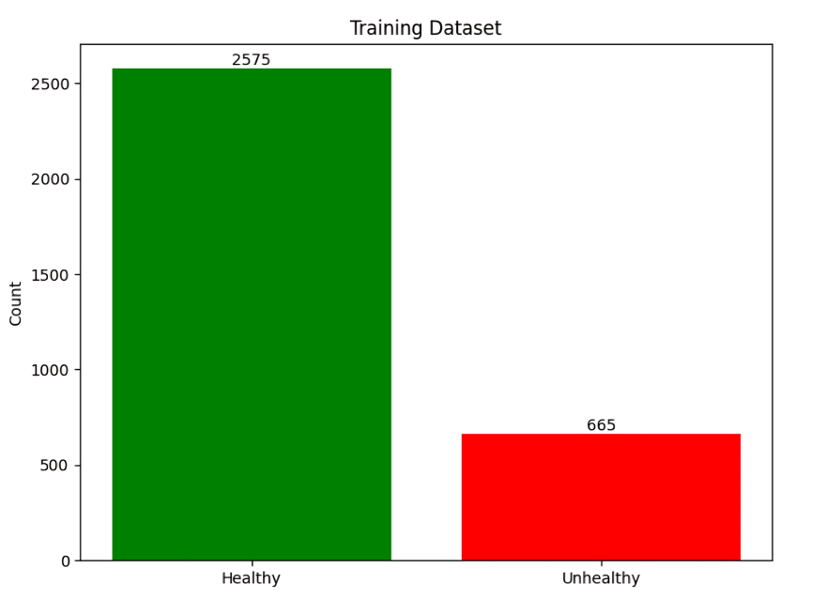
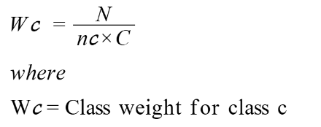
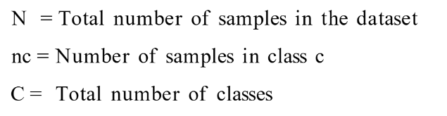
Exploratory Data Analysis (EDA)
EDA was performed to understand the distribution of the dataset:
Class Imbalance: The dataset was analyzed for class imbalance, where the "healthy" class had significantly more samples than the "unhealthy" class. Class weights were adjusted during training to ensure balanced learning. Formula for calculating class weight:

Slide 13
Fig :- CNN-Based Model
Model :
CNN-Based Model :
Purpose: Deep learning model designed for the classification of PCG signals into healthy and unhealthy categories.
Strength: Excels in extracting spatial and temporal features from Gammatonegram images, providing high accuracy and robustness against noise.
Optimization: Various optimizers (Adam, SGD, RMSProp) were tested; Adam proved the most effective.
Result: Achieved 100% accuracy on the test dataset using the Adam optimizer, demonstrating its reliability for heart sound classification.
Optimizers :
SGD
Adagrad
Adadelta
RMSprop
Adam

Slide 14
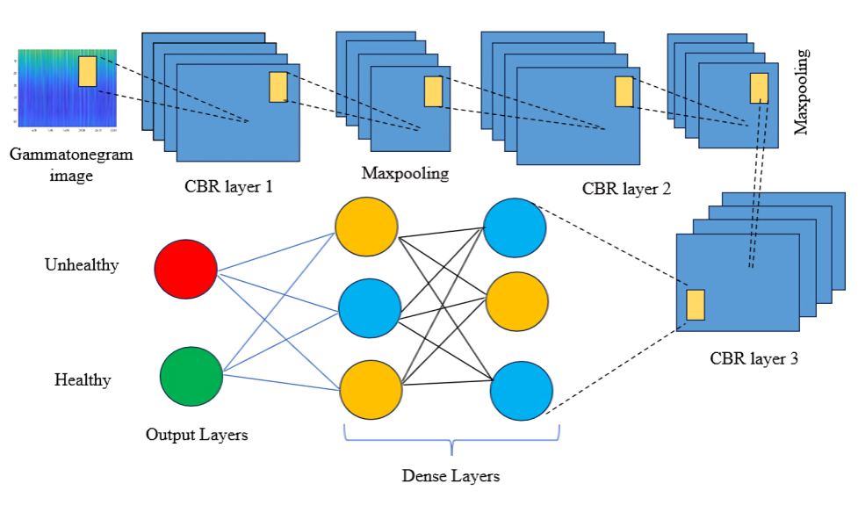

Slide 15
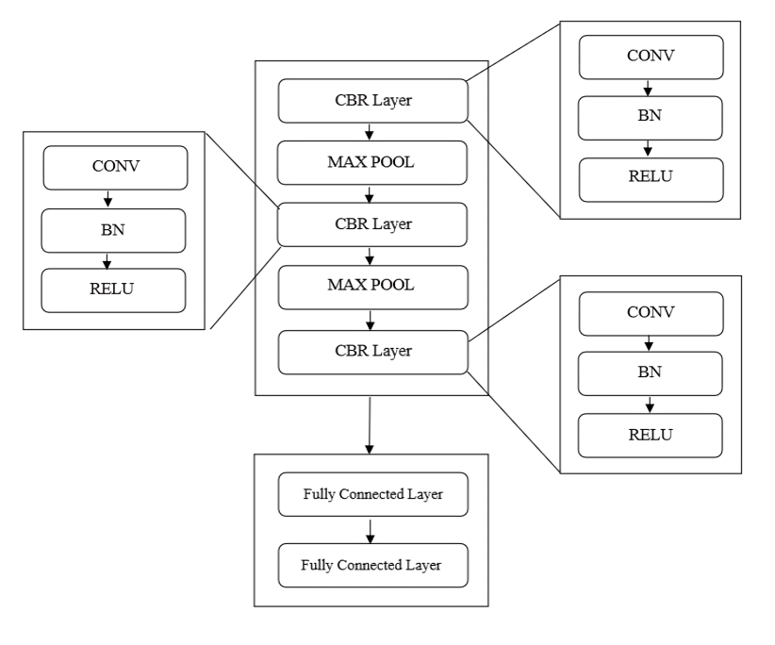
Input Layer
Input: 150x150x3 Gammatonegram image.
Output: Sent to first Conv2D layer.
Conv2D Layer 1
Output: 150x150x12 feature map.
Max-Pooling Layer 1
Output: 75x75x12 feature map.
Conv2D Layer 2
Output: 75x75x20 feature map.
Conv2D Layer 3
Output: 75x75x32 feature map.
Max-Pooling Layer 2
Output: 37x37x32 feature map.
Flattening Layer
Output: 43,888 features.
Fully Connected Layers
Layer 1: 256 features.
Layer 2: 128 features.
Output Layer: Probabilities for "Healthy" and "Unhealthy."

Slide 16
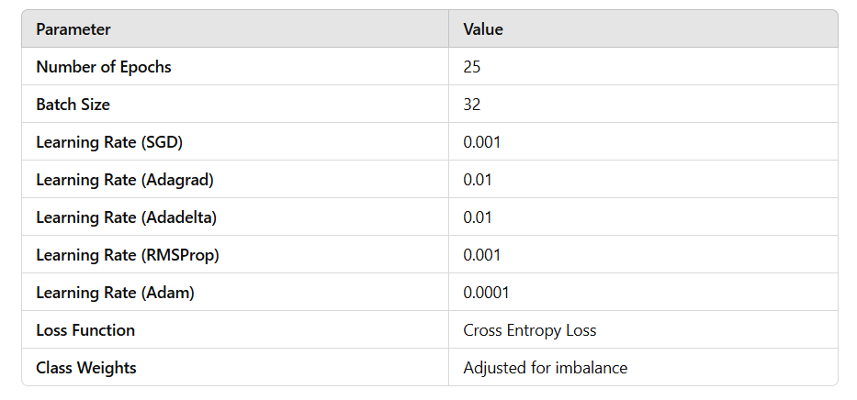

Slide 17
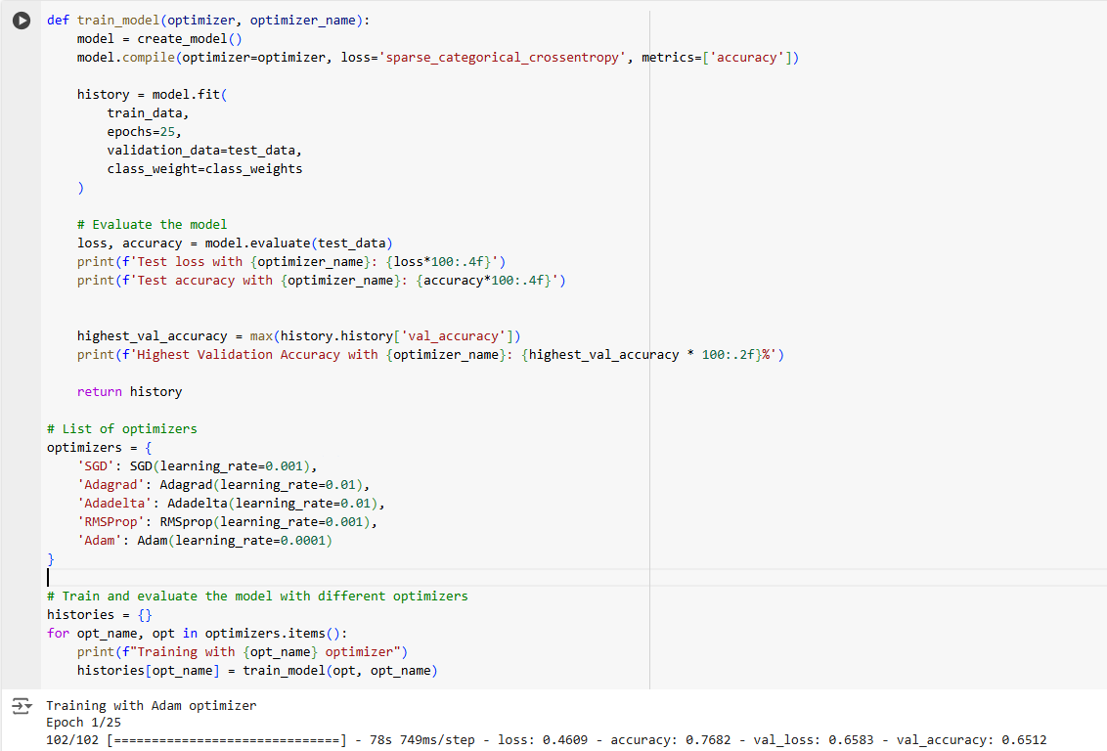
IMPLEMENTATION

Slide 18
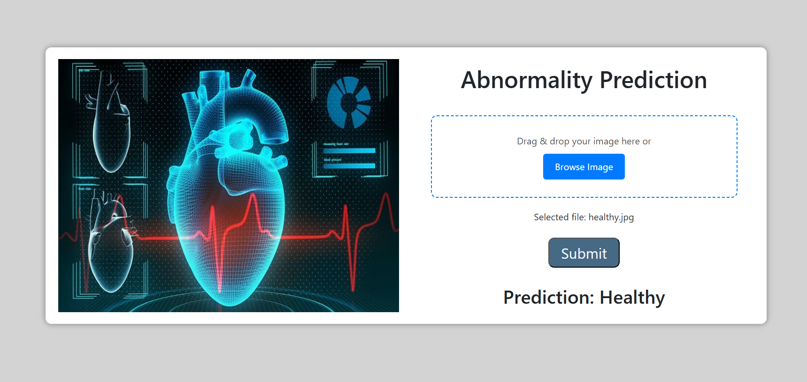

Slide 19
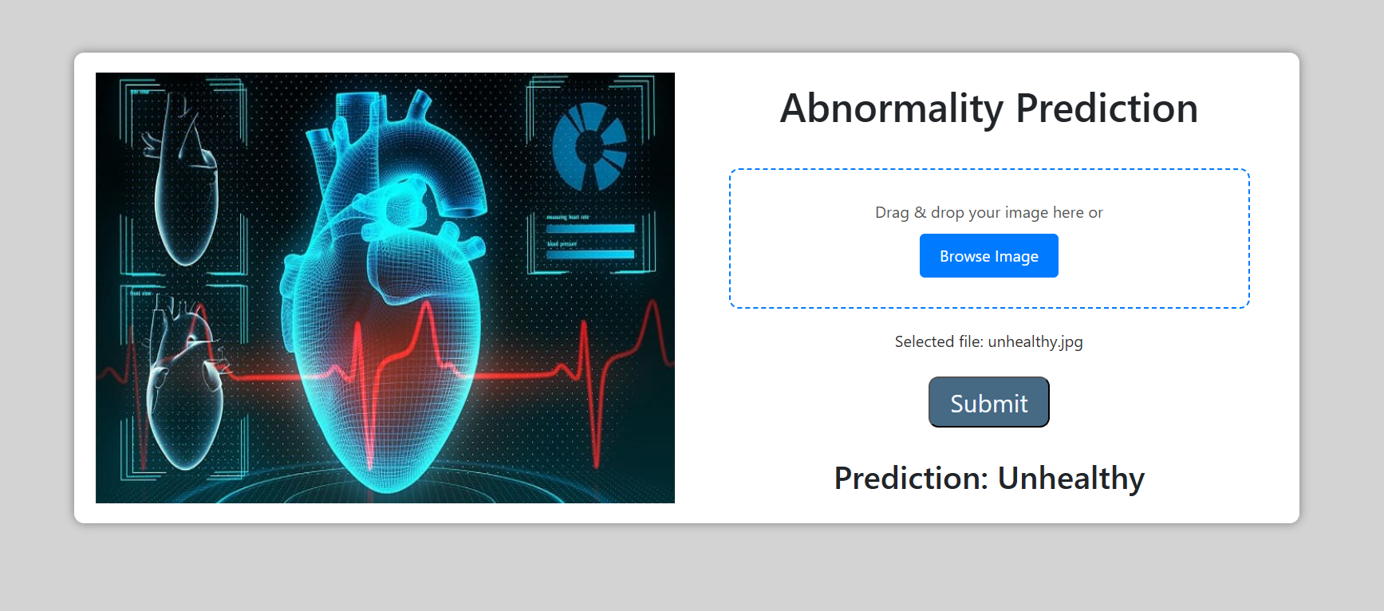

Slide 20
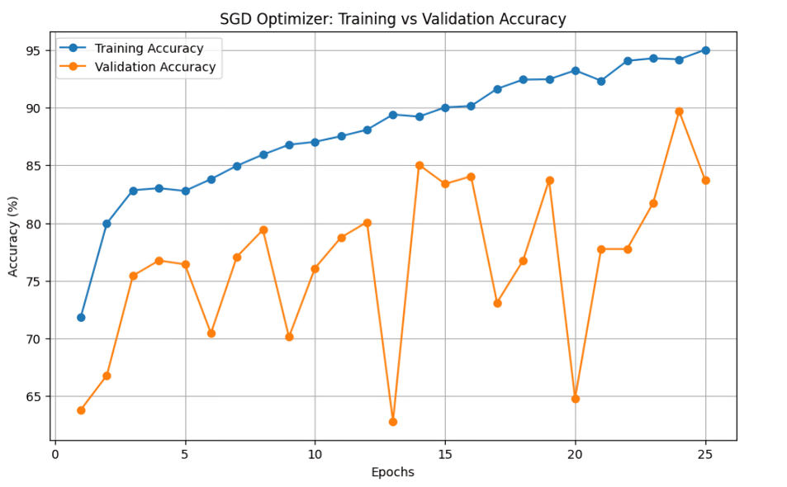
RESULTS & ANALYSIS

Slide 21
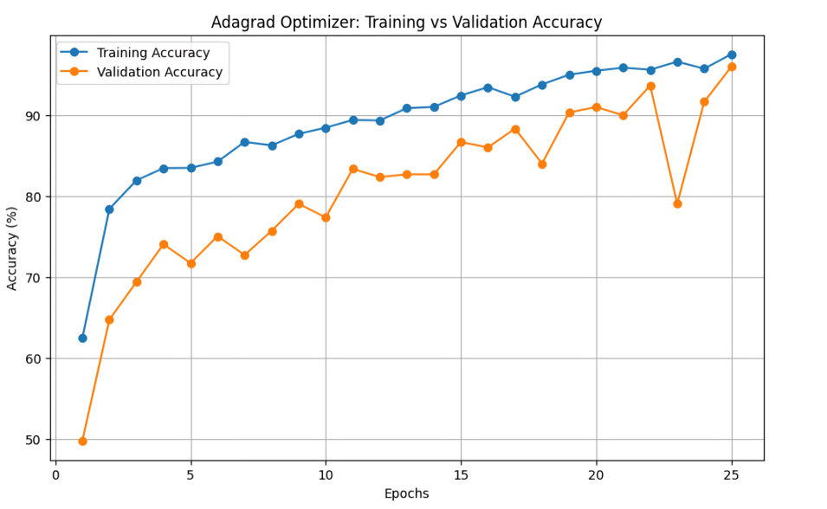

Slide 22
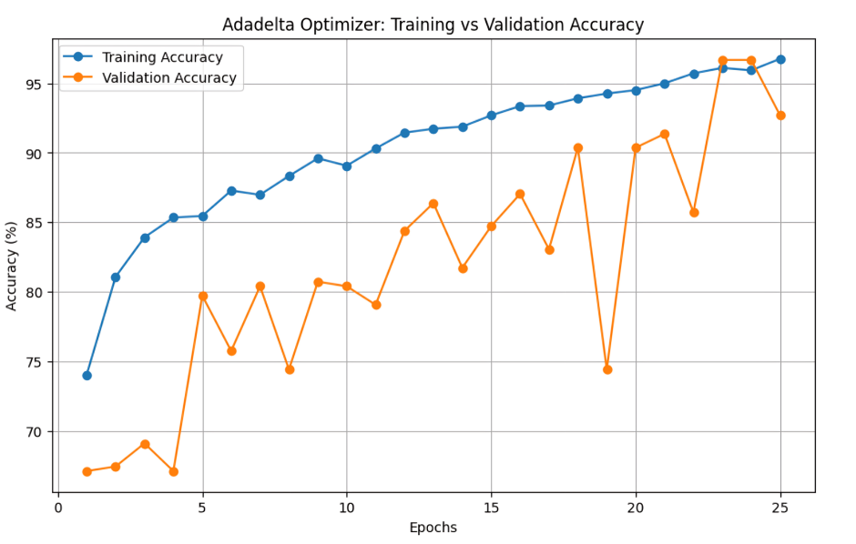

Slide 23
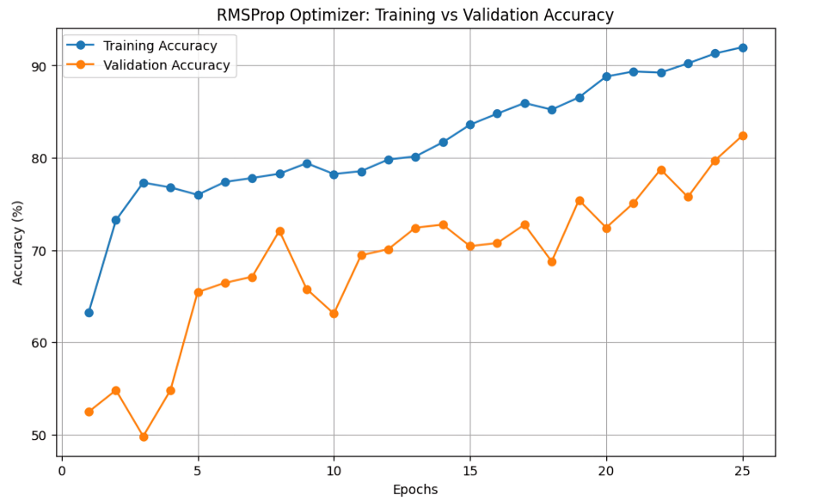

Slide 24
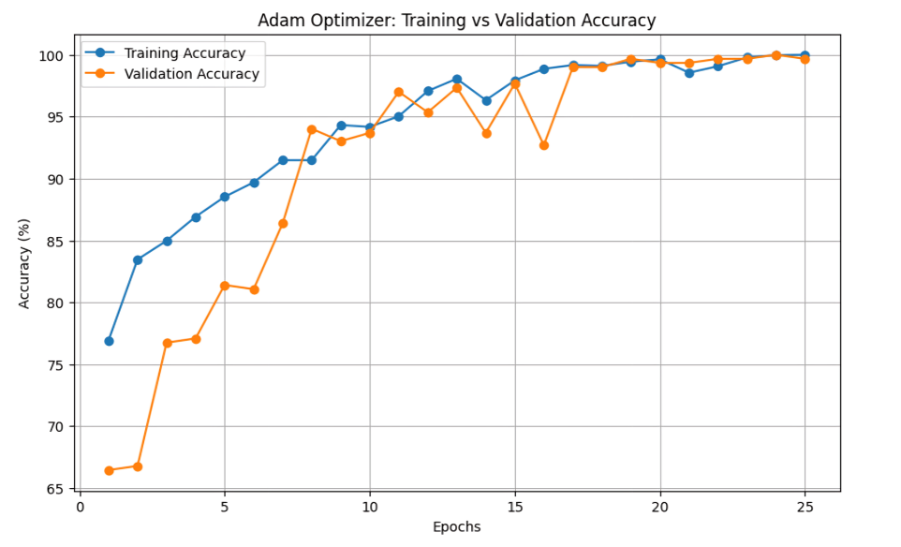

Slide 25
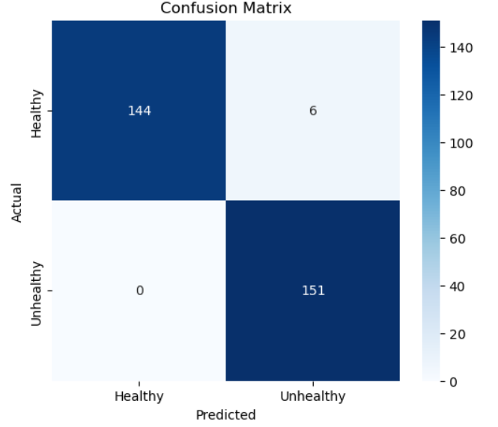
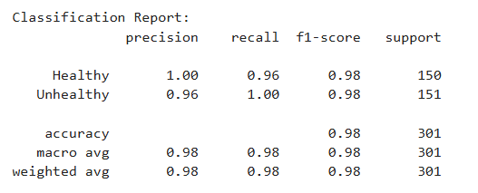

Slide 26
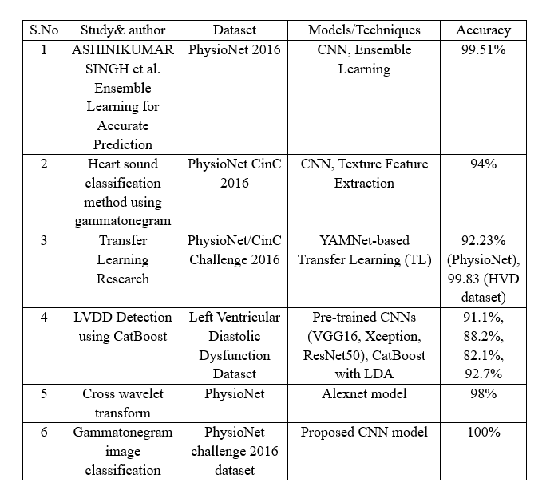

Slide 27
CONCLUSION & FUTURE SCOPE
In conclusion, the proposed method using Gammatonegram-based analysis with CNN offers a simple yet effective approach for detecting abnormalities in PCG signals. By transforming PCG signals into Gammatonegram images, and applying preprocessing techniques like resizing and random horizontal flip augmentation, the model can accurately classify healthy and unhealthy heart sounds. Among the optimizers tested, the Adam optimizer achieved the highest accuracy of 100%, demonstrating its effectiveness. This study confirms that Gammatonegram representations are highly suitable for the classification of PCG signals, offering a reliable method for heart disease detection. Future work includes :
Expanding the dataset for diverse cardiac conditions.
Integrating the system with wearable devices for real-time monitoring.
Exploring hybrid models for further performance improvements.
Adapting the methodology for other biomedical signal analyses.

Slide 28
REFERENCES
[1] Cheung, Ka Wang, M. Bonet, K. A. Frank, O. T. Oladapo, G. J. Hofmeyr, WHO Intrapartum Care Algorithms Working Group, Livia Ciabati et al. ”Clinical algorithms for management of fetal heart rate abnormalities during labour.” BJOG: An International Journal of Obstetrics & Gynae cology 131 (2024): 102-111.
[2] Tunnell, Natalie C., Sarah E. Corner, Andres D. Roque, Juliet L. Kroll, Thomas Ritz, and Alicia E. Meuret. ”Biobehavioral approach to distinguishing panic symptoms from medical illness.” Frontiers in Psychiatry 15 (2024): 1296569.
[3] Duca, S ¸tefania-Teodora, Ionut¸ Tudorancea, Radu-S ¸tefan Miftode, Adri ana Chetran, Alexandru-Dan Costache, D. Robert Pav˘ al, and Irina Iuliana Costache-Enache. ”Heartbeat Chronicles: Decoding the Interplay of Echocardiography and Heart Rate Variability in Chronic Heart Failure Patients–Unraveling the Mysteries with Traditional and Advanced 24 Hour Holter ECG Parameters.” Romanian Journal of Cardiology.

Slide 29
[4] Lee, Joon-Hyop, EunKyung Ku, Yoo Seung Chung, Young Jae Kim, and Kwang Gi Kim. ”Intraoperative detection of parathyroid glands using artificial intelligence: optimizing medical image training with data augmentation methods.” Surgical Endoscopy 38, no. 10 (2024): 5732 5745.
[5] M.Sireesha, S. N. TirumalaRao, Srikanth Vemuru, Optimized Feature Extraction and Hybrid Classification Model for Heart Disease Prediction International Journal of Recent Technology and Engineering Vol- 7, No 6, Mar- 2019 ISSN- 2277-3878, Pages– 1754– 1772.
[6] Lee, T. H., E. F. Shair, A. R. Abdullah, K. A. Rahman, and N. Nazmi. ”Comparison of Short Fast Fourier Transform and Continuous Wavelet Transform in Study of Stride Interval.”
[7] M.Sireesha, Srikanth Vemuru, S.N.Tirumala Rao “Classification Model for Prediction of Heart Disease Using Correlation Coefficient Tech nique” International Journal of Advanced Trends in Computer Science and Engineering, Vol. 9, No. 2, March- April 2020, Pages- 2116 2123.

Slide 30
[7] M.Sireesha, Srikanth Vemuru, S.N.Tirumala Rao “Classification Model for Prediction of Heart Disease Using Correlation Coefficient Tech nique” International Journal of Advanced Trends in Computer Science and Engineering, Vol. 9, No. 2, March- April 2020, Pages- 2116 2123.
[8] Chambi, Edwin M., Jefry Cuela, Milagros Zegarra, Erasmo Sulla, and Jorge Rendulich. ”Benchmarking Time-Frequency Representations of Phonocardiogram Signals for Classification of Valvular Heart Diseases Using Deep Features and Machine Learning.” Electronics 13, no. 15 (2024): 2912.
[9] Arslan, Muhammad, Muhammad Mubeen, Muhammad Bilal, and Saadullah Farooq Abbasi. ”1D-CNN-IDS: 1D CNN-based Intrusion Detection System for IIoT.” arXiv preprint arXiv:2409.08529 (2024).
[10] Ahmad, Ahsan, Ali Husnain, Ashish Shiwlani, Ahad Hussain, Mahnoor N. Gondal, and Ayesha Saeed. ”Ethical and clinical implications of AI integration in cardiovascular healthcare.” World Journal of Advanced Research and Reviews 23, no. 3 (2024): 2479-2501.

Slide 31
[11] ASHINIKUMAR SINGH, S. I. N. A. M., S. I. N. A. M. Ajitkumar SINGH, and A. H. E. I. B. A. M. DINAMANI SINGH. ”Ensemble Learning for Accurate Prediction of Heart Sounds using Gammatone gram Images.” Turkish Journal of Electrical Engineering and Computer Sciences 32, no. 4 (2024): 555-573.
[12] Taneja, Kriti, Vinay Arora, and Karun Verma. ”Heart sound classifica tion method using gammatonegram and SVM.” Multimedia Tools and Applications (2024): 1-37.
[13] Maity, Arnab, Akanksha Pathak, and Goutam Saha. ”Transfer learning based heart valve disease classification from Phonocardiogram signal.” Biomedical Signal Processing and Control 85 (2023): 104805.
[14] Zheng, Yineng, Xingming Guo, Yang Yang, Hui Wang, Kangla Liao, and Jian Qin. ”Phonocardiogram transfer learning-based CatBoost model for diastolic dysfunction identification using multiple domain-specific deep feature fusion.” Computers in Biology and Medicine 156 (2023): 106707.
[15] Ismael, Mustafa R., Haider J. Abd, and Raad Z. Homod. ”Classification of Phonocardiogram Signals Using the Wavelet Scattering Transform and Equilibrium Optimization Approach.” (2024).

Slide 32
QUESTIONS & ANSWERS
Open the floor for questions from the audience

Slide 33
ACKNOWLEGEMENTS
Express gratitude for the opportunity to present
Provide contact information for further inquiries

Slide 34
Thank you

